Slide 1
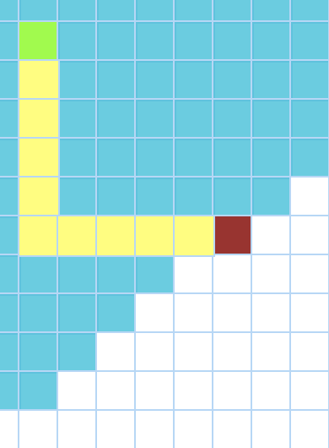

VISUALGO
Interactive Web App for visualizing algorithms

Slide 2

Our Team
(Mentor and Guide)
Dr. Ashok Garai
Rishi Raj Yadav Tanay Makharia Dhananjay Sharma
19ucs045 19ucs122 19ume041

Slide 3

INTRODUCTION
OUR APPLICATION :-
VISUALGO is an interactive web application in which:
PathFinding Visualizer
Visualize path between two node using different path finding algorithms
Sorting Visualizer
Visualize how an array is sorted using different sorting algorithms

Slide 4

MOTIVATION
It is difficult to understand complex algorithms for someone who is a beginner, so this problem motivated us to come up with a solution for it.
Learners can understand the working of these complex and tricky algorithms by visualizing them through animation (using transitions, colours, etc.) as visualization is the best and most scientific method to understand something.

Slide 5

RELATED WORK
Some work is already done on this idea :-
PathFinding Visualizer
https://pathfindout.com/
Sorting Visualizer
https://clementmihailescu.github.io/Sorting-Visualizer/

Slide 6

HOW OUR PROJECT IS DIFFERENT
We have used React as our tool to create the the frontend.
We made our project which can be operated by anyone easily.
We included all the important algorithms in our visualization stream which almost all students may face somewhere their life.

Slide 7

ABOUT OUR PROJECT
This project is for educational purpose. The main objective of this project is to help beginners to be able to visualize the basic algorithms and get a better understanding of the underlying operations.
Algorithm visualizer is a web-application build in React. It contains UI component and interpretes commands into visualization.
Our project contains two type of algorithms :- 1) Sorting Algorithms and 2) Path Finding Algorithms.

Slide 8




TECH STACK USED
React
HTML5
Javascript
CSS

Slide 9
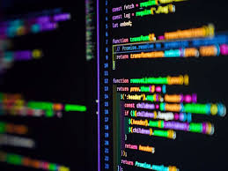
WHY REACT ?
Reusable Components
Fast Learning Curve
Fast render with Virtual DOM
Clean Abstraction
Great Developer Tools

Slide 10

ROADMAP

Slide 11




PROJECT STAGES
STEP 04
STEP 03
Deployment
Building Website and adding features
STEP 02
STEP 01
Learning the Required technologies
Planning the project detail

Slide 12
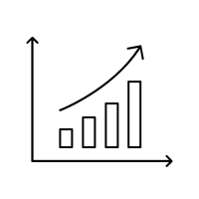
TIMELINE
DECEMBER’22
Further Optimizations and deployment
FEBRUARY’22
Learning the required technologies
DECEMBER’21
Approval and idea Finalized
MAY’22
Completing the recycling website Frontend
JANUARY’22
Designing & Brainstorming Features and Techstack

Slide 13
Pathfinding Visualizer
Functions
Clear Board - Clears the entire board.
Visualize - visualize the selected algorithm.
Dropdown - select desired algorithm.

Slide 14
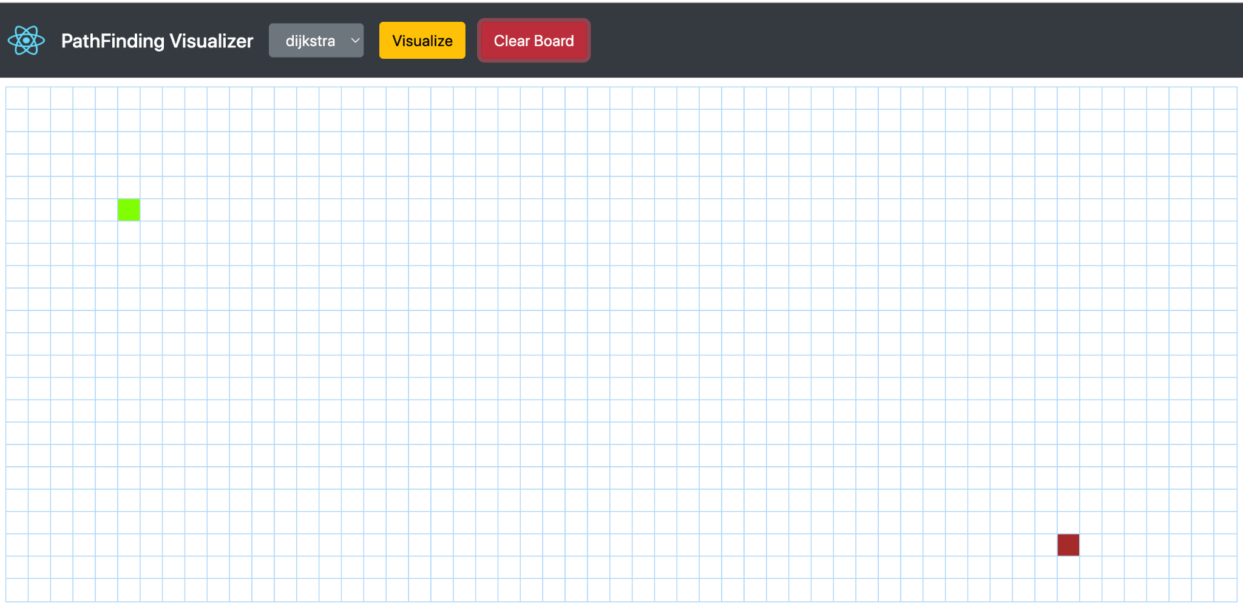

Slide 15
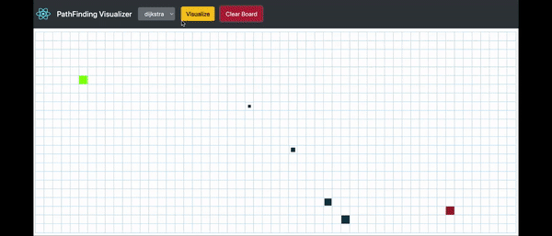
Demonstration of PathFinding Visualizer

Slide 16
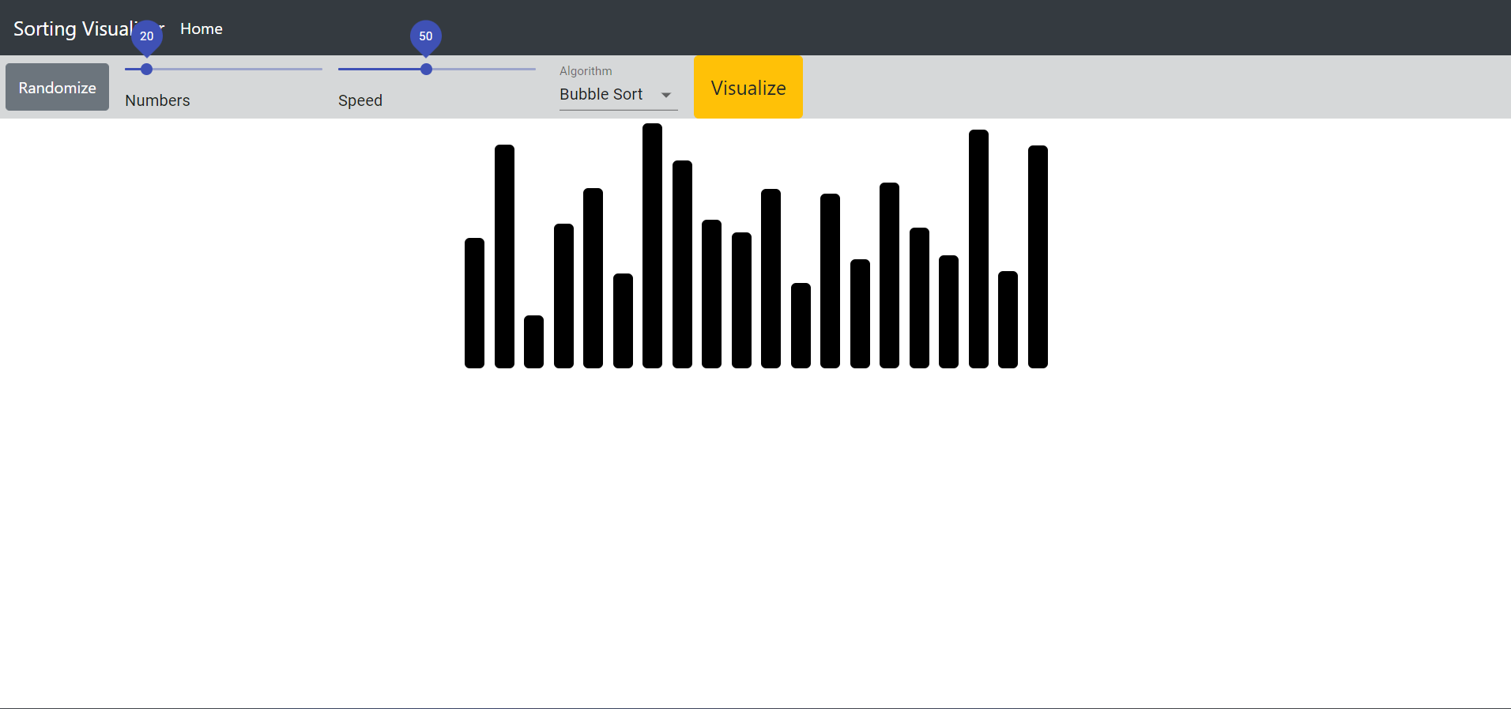
Sorting Visualizer
In this sorting visualizer we can randomize the numbers, set range of numbers, speed of visualization and can select the algorithm to visualize.
This Sorting Visualizer helps new learners to easily understand the sorting techniques via visualization.Visualization makes the learning easy and interesting.

Slide 17
Function of Sorting Visualizer
Randomize- It will randomize the numbers that makes the sorting interesting.
Numbers- It lets us to select the number of bars to visualize
Speed- We can set the speed of algorithm using this function
Algorithm- It lets us to select the algorithm to apply on the number to visualizer
Visualize- It visualizes the selected algorithm

Slide 18
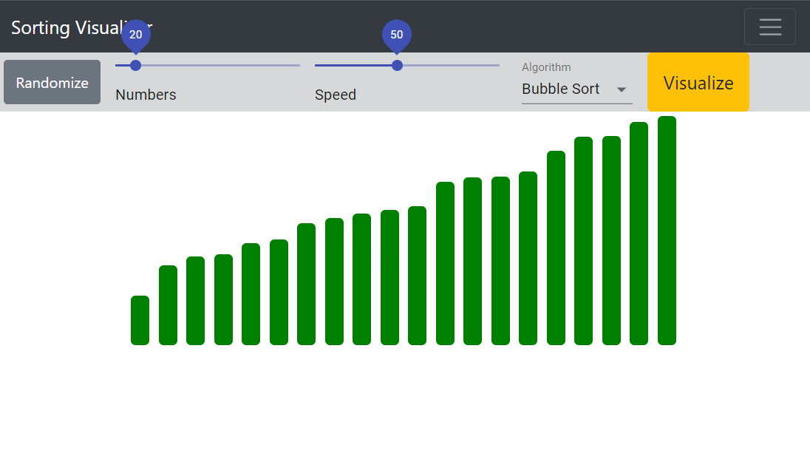
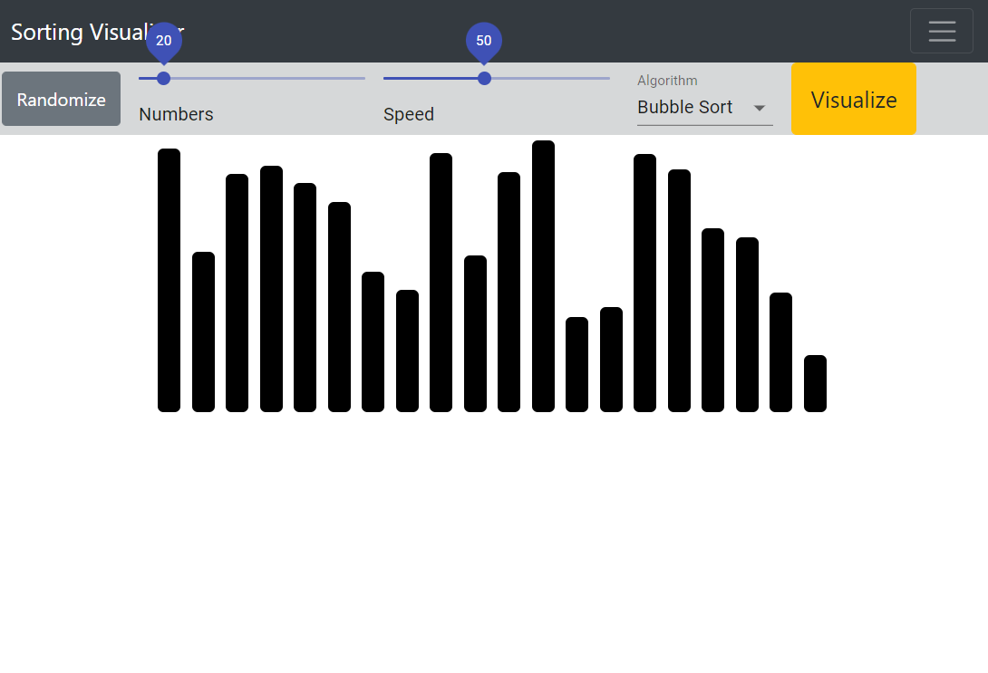
On Randomize

Slide 19
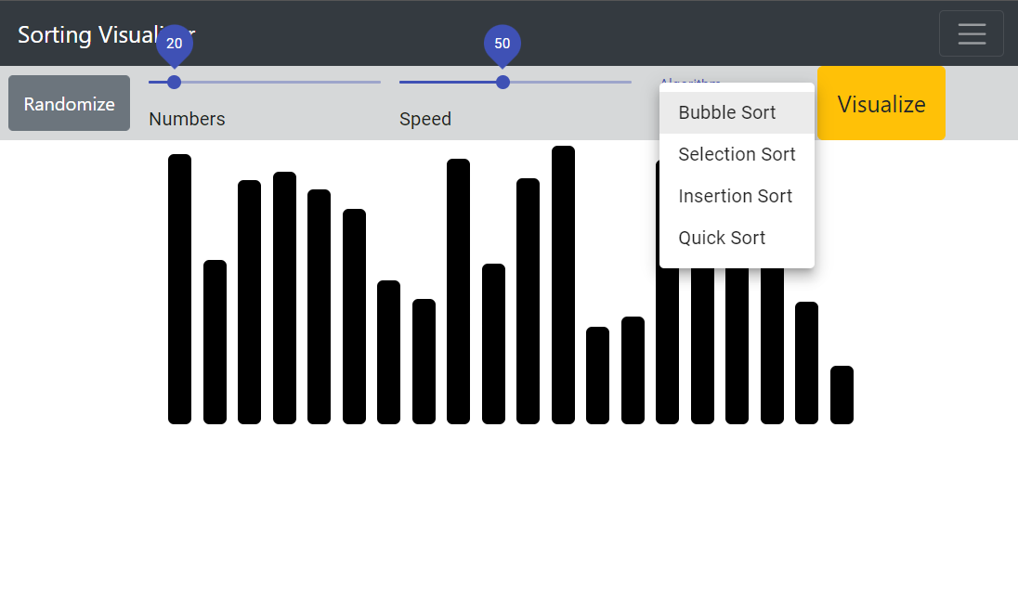
Selecting Algorithm to visualize
Selecting algorithm

Slide 20
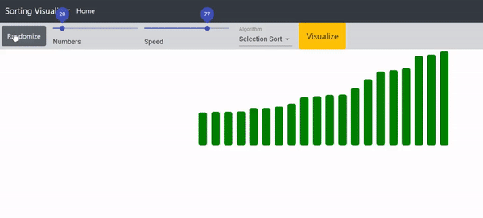
Demonstration of Sorting Visualizer

Slide 21
REFERENCES
https://clementmihailescu.github.io/Sorting-Visualizer/
https://github.com/topics/sorting-visualization?l=javascript
https://clementmihailescu.github.io/Pathfinding-Visualizer/
https://www.youtube.com/watch?v=msttfIHHkak
https://www.youtube.com/watch?v=pFXYym4Wbkc&t=867s

Slide 22
THANK YOU

